Slide 1
CaAERS-CTEP
July 6 Review Meeting

Slide 2
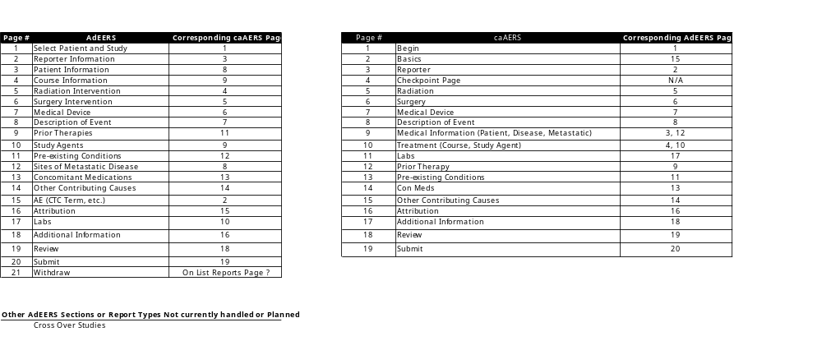
AdEERS - CaAERS Map
caAERS has a corresponding section for each and every AdEERS section

Slide 3
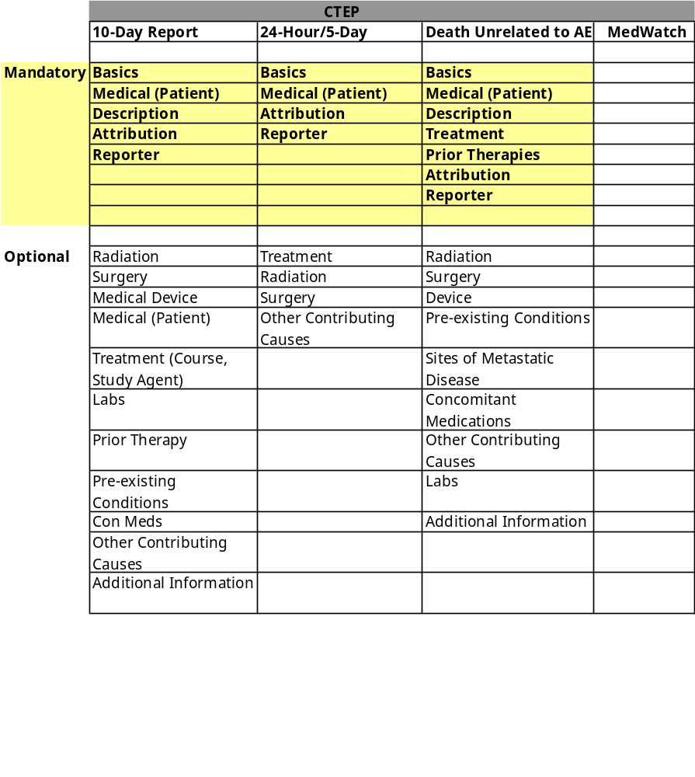
Required/Optional Sections

Slide 4
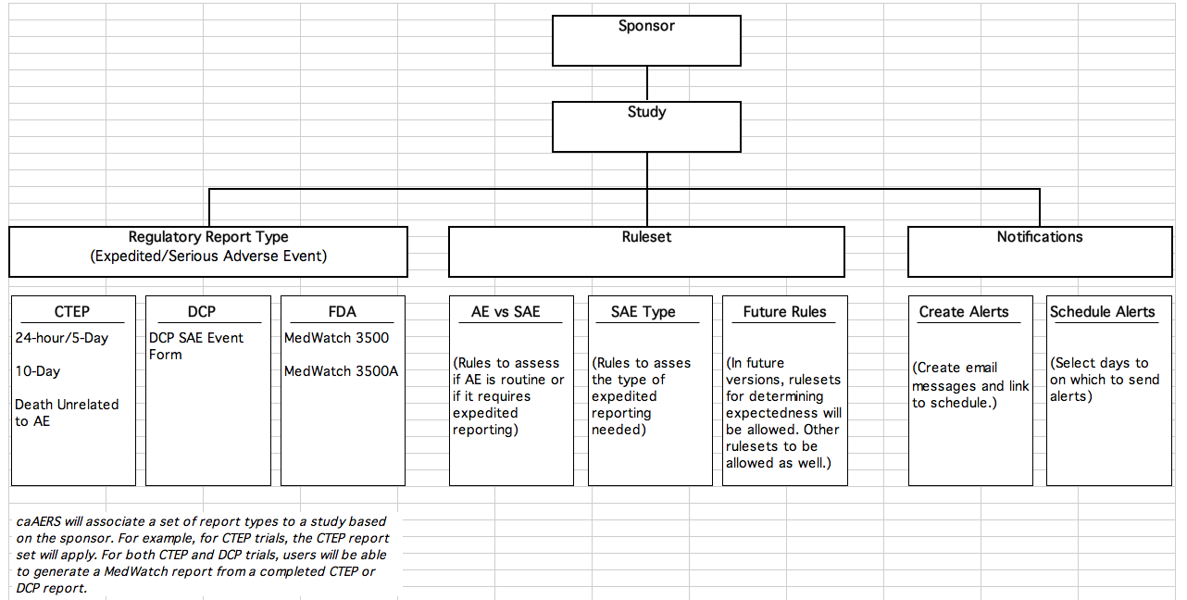
System Diagram - How caAERS will handle report types, rulesets, and notifications

